Slide 1
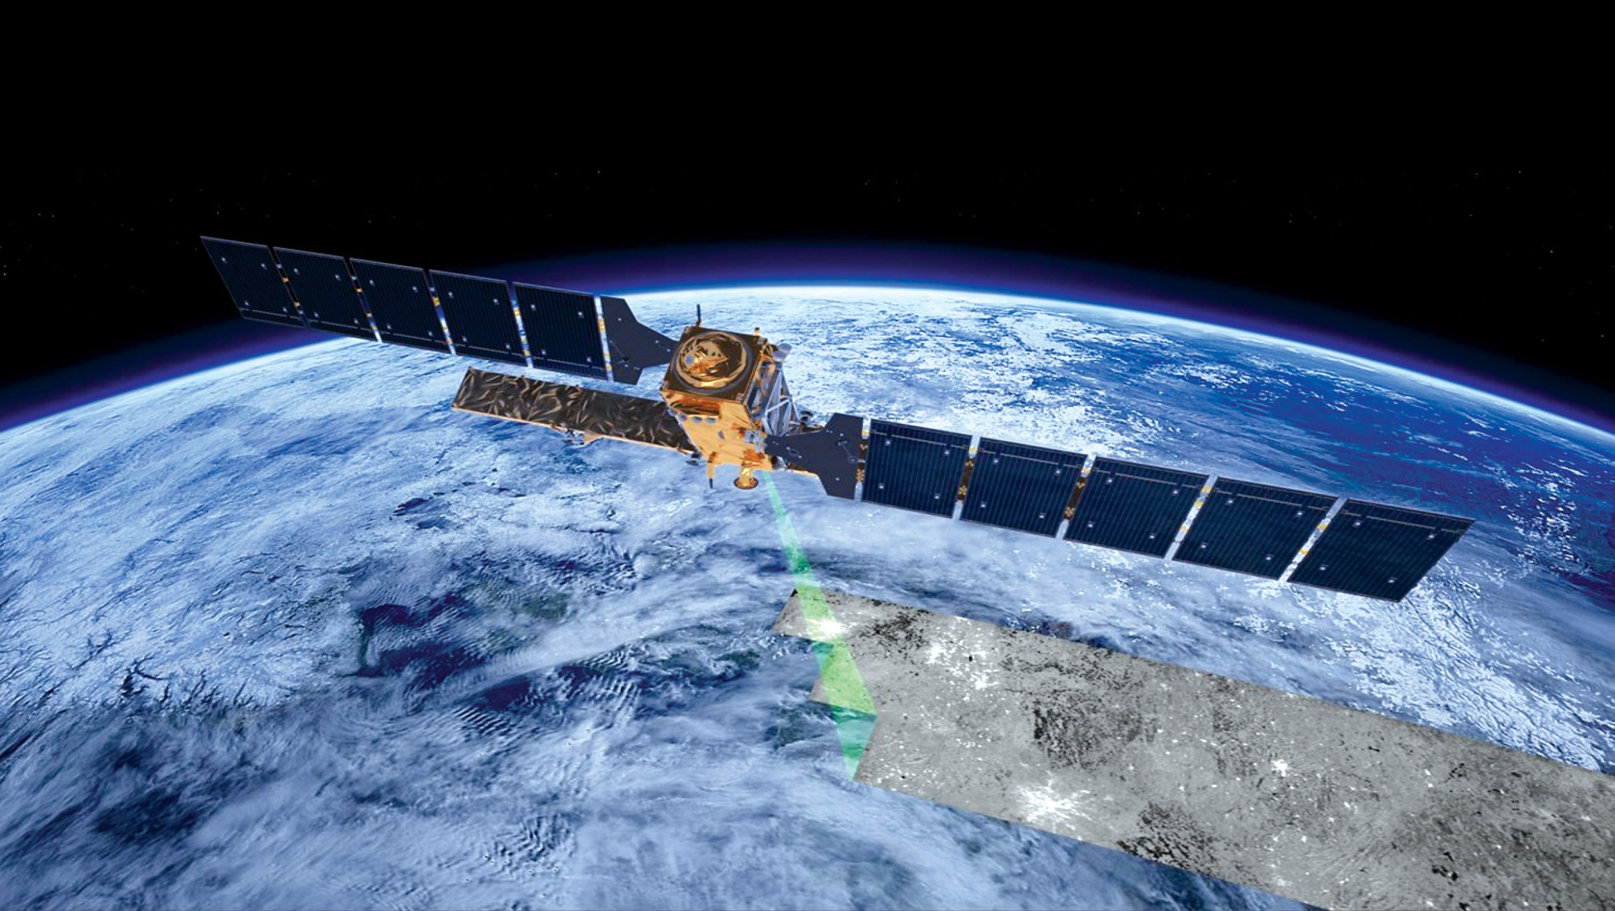

Earth observation data analysis in the age of big data
Gilberto Câmara
GEO Secretariat Director
image: ESA

Slide 2
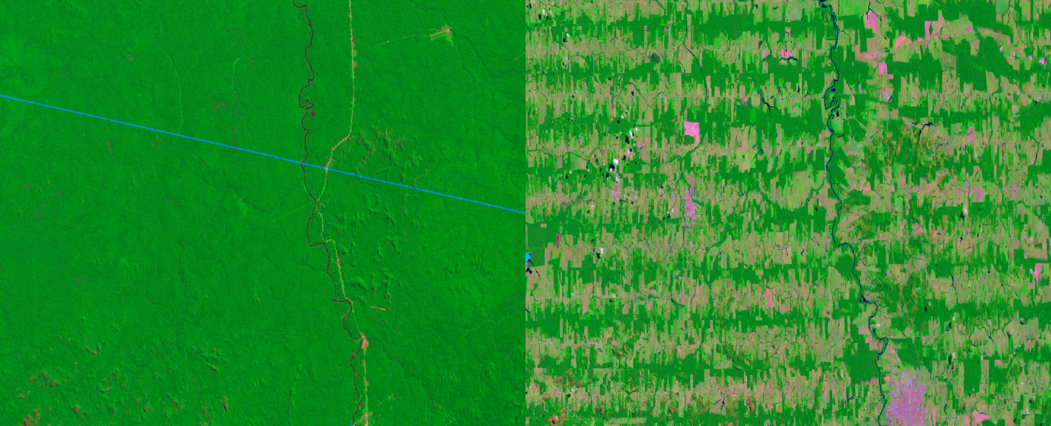
The value of Earth observations
Objective information
Covers inacessible areas
Near real time
Historical record
images: USGS

Slide 3
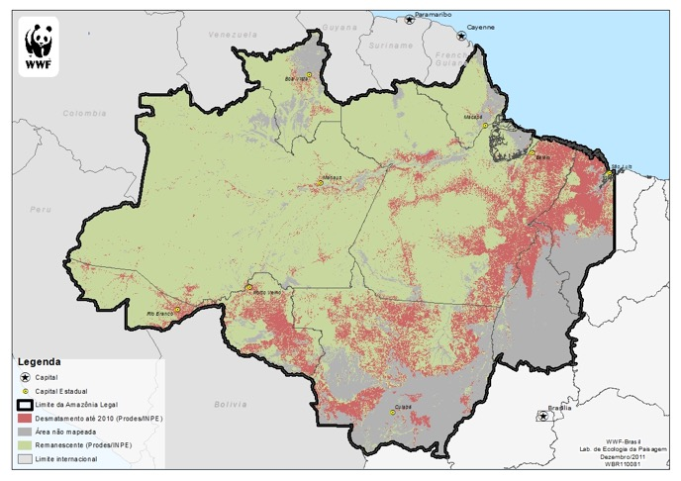

The value of Earth observation: How much? Where? When? Who?

Slide 4

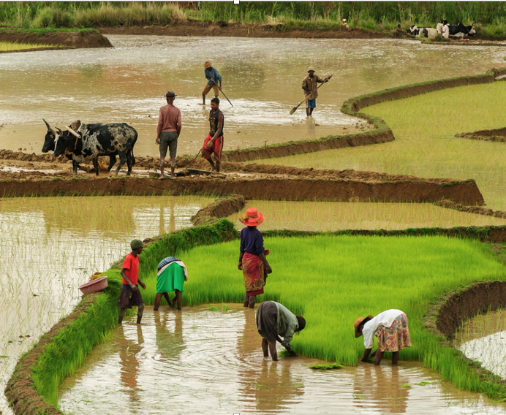
How is the Earth’s environment changing, and what are the consequences for our civilization?
Where are changes taking place?
How much change is happening?
Who is being impacted by the change?
images: shutterstock

Slide 5
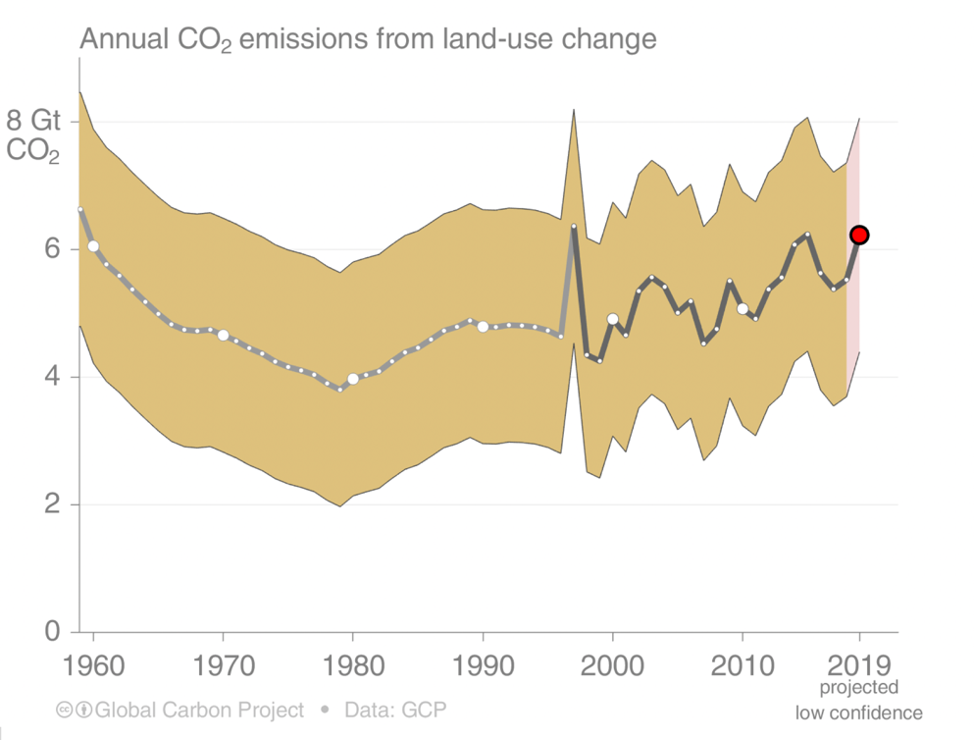
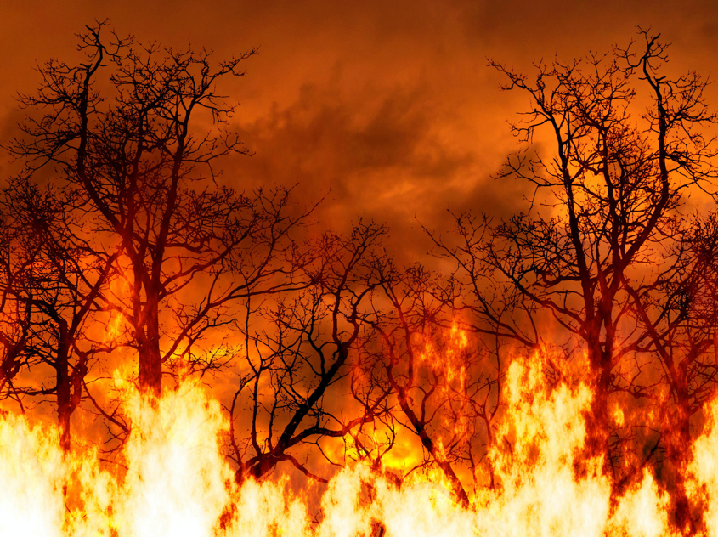
Land use change emissions
Land-use change emissions are highly uncertain, with no clear trend in the last decade.
source: Global Carbon Project

Slide 6
The Paris Agreement
National measures (NDC + NAP)
INTERNATIONAL LEVEL
Progress reports every 2 y
Limit global warming
Adapt to a low-carbon economy
Finance green growth
Global stocktake (2023 => every 5 y)
Revision of national measures
NATIONAL LEVEL
Recommendations
IPCC assessments
Source: Joanna Post (UNFCCC)
Notes:
The Paris Agreement is the main international climate change treaty;
It‘s goals are: 1. keep global warming below +2 C, or preferably +1.5 degrees;
2. to enhance ability to adapt to changes;
increase resilience, and increase finance flows in the context of sustainable development
To reach these goals, the Paris Agreement outlines a „cycle“:
Top left: countries provide a national climate target every 5 y; they are „nationally determined“, but must be stronger than the previous targets; Communicated individual efforts every 5 years
Starting in 2024 countries will report on progress – and reporting will take place every 2 years Every 2 years, countries report on emissions; reporting is more flexible for developing countries, but all should move towards stricter reporting over time;
A globalstocktaking happens every 5 y to consider:
implementation;
2. collective progress towards the goals; for adaptation: progress towards adaptation goal and adequacy and effectiveness of adaptation action
3. The stocktaking recommends ways to be more ambitious in the next cycle;
Countries take the recommendations and their experiences home, and then, provide more ambitious targets in the next 5 year cycle.
Transparency to build trust and confidence:
GHG Inventory
Progress on NDCs
Support provided
Support needed and received
Adaptation
L&D
In the Paris Agreement Article 14 The Global Stocktake, Parties agreed to measure collective progress towards achievement of the Paris Agreement goals: mitigation, adaptation, and the means of implementation and support. At the first meeting of the Conference of the Parties serving as the meeting of the Parties to the Paris Agreement (CMA) in 2018, Parties further decided that the global stocktake (GST) may also consider efforts on the social and economic consequences of response measures and averting, minimizing and addressing loss and damage.
Opportunities for observation / data community to support the work of the GST – directly to Parties and to global process under UNFCCC

Slide 7
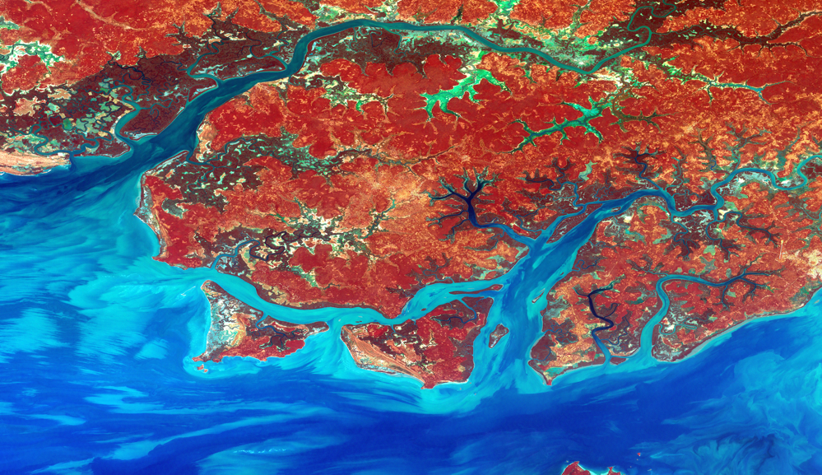
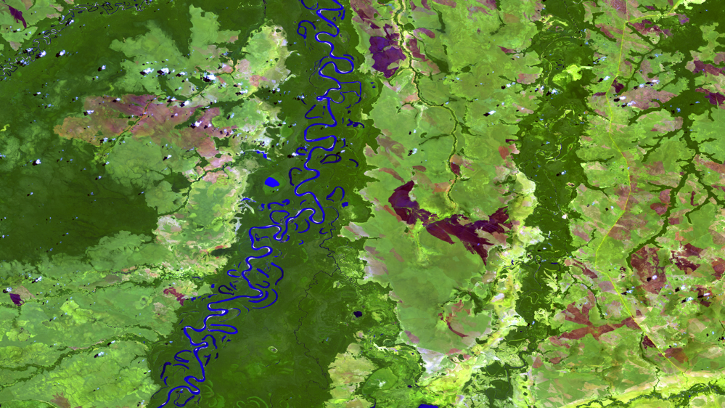
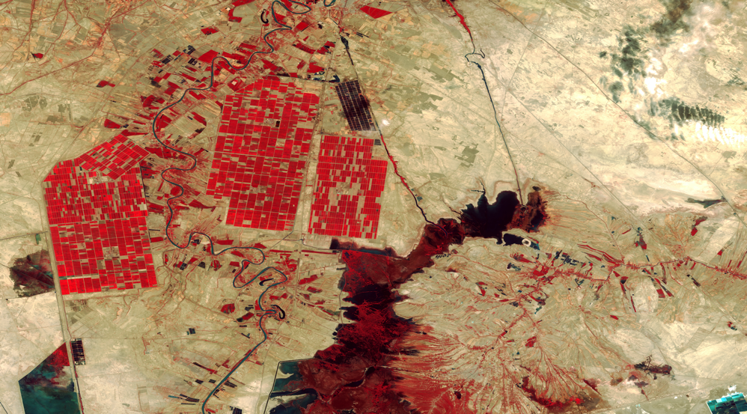
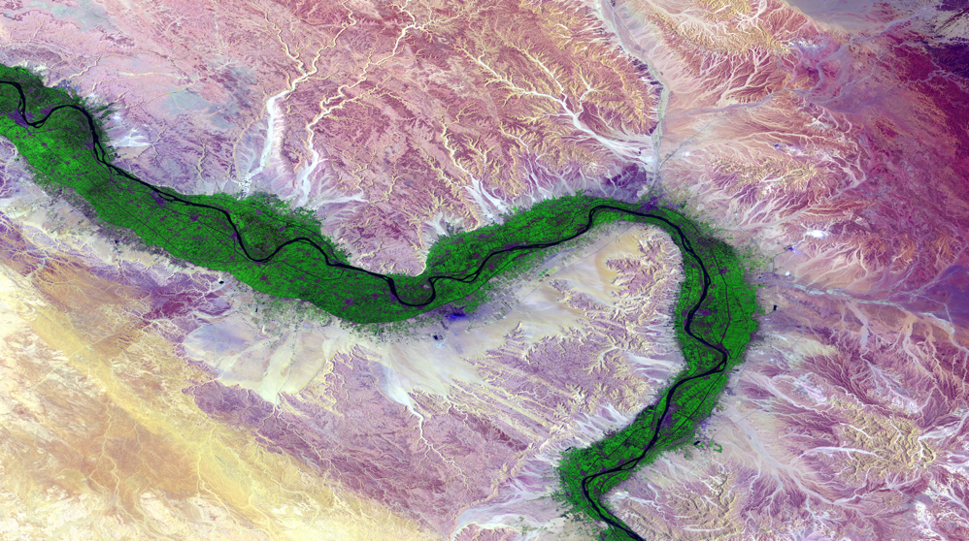
RIO-92 Declaration – principle #10
Environmental issues are best handled with participation of all citizens. Each individual shall have appropriate access to information concerning the environment.
images: USGS

Slide 8
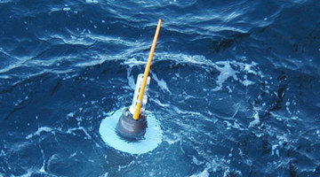

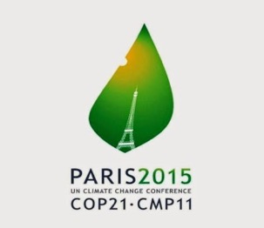

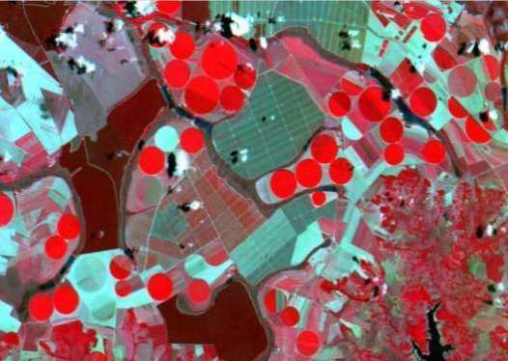
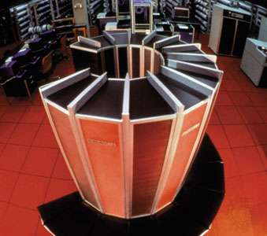


How does GEO work?
community
data
analysis
agreements

Slide 9
The age of big Earth observation data
Terra
Sentinel-1/1A
Sentinel-2/2A
Landsat-8
Sentinel-3
CBERS-4/4A

Slide 10
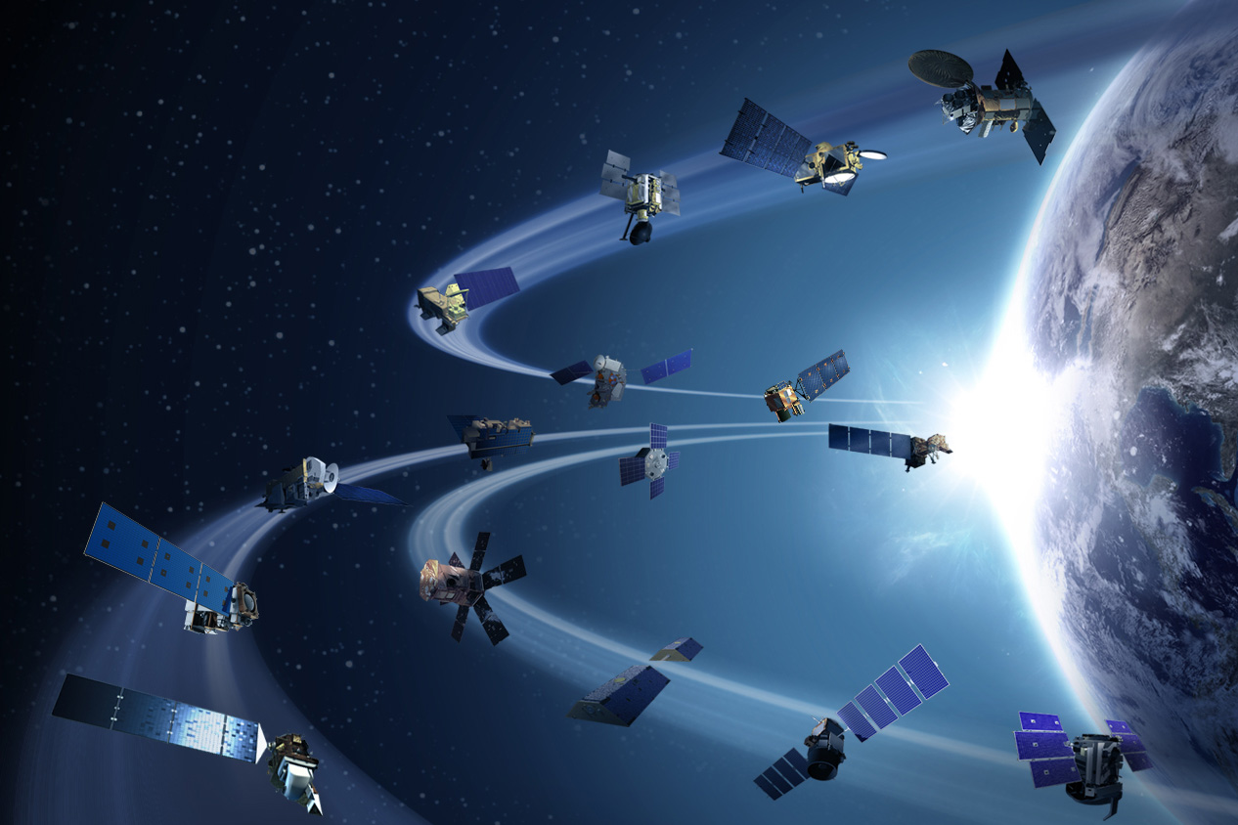
Open data policy for EO satellite data
Europe, US, Brazil, China, Japan
(> 15 TB per day)

Slide 11

How to share and process so much EO data?
Cloud services: move the user to the data!

Slide 12


The new digital economy
images: shutterstock
Low access cost
big data
public APIs
massive use
Google, Twitter, Facebook, Spotify, Waze,…

Slide 13
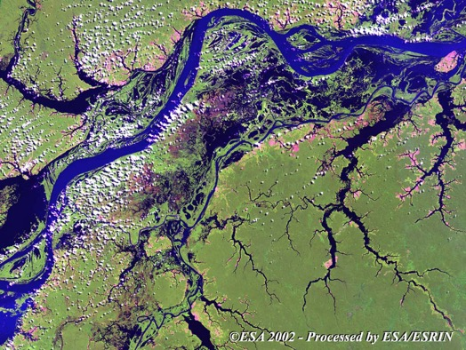
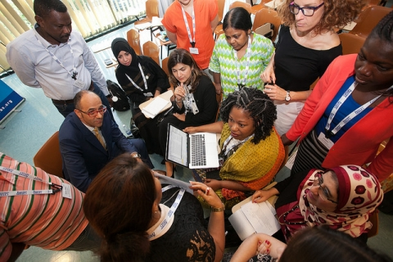

Challenge: Capable institutions delivering operational and transparent EO products
Trust is the key!
socially robust results
EO data
co-design & co-production

Slide 14


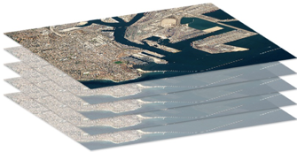
What the global EO community needs
images: shutterstock
Empowered institutions
Reusable, shared knowledge
Open cloud platforms

Slide 15
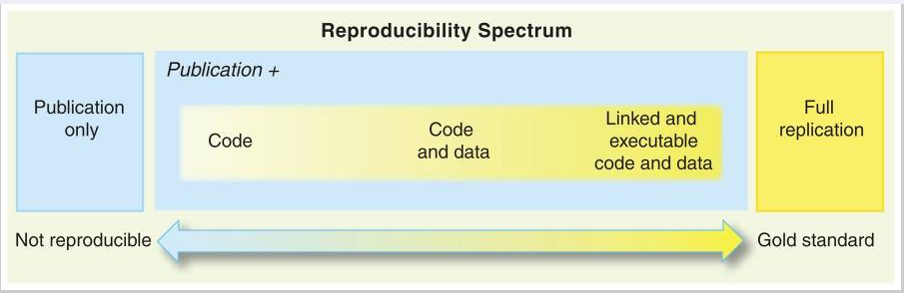
Achieving reproducible knowledge
Exposing all parts of an application
image: Peng (Science, 2011)

Slide 16

Who’s afraid of the MAGI?
Global monopolies
or
cost/effective platforms?

Slide 17

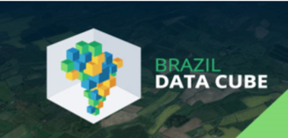
A pragmatic approach to the MAGI
Open Earth Alliance
Open source: vendor independence, level-playing field, globally accessible

Slide 18
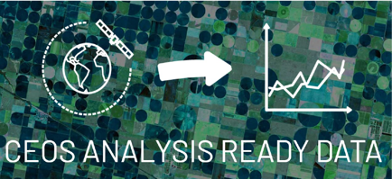



Recent progress in big EO data
Data on clouds
Sentinel-2
Landsat
Digital Earth Africa
Swiss Data Cube
Brazil Data Cube
DCoD
Open Earth Alliance

Slide 19
How to build data cubes?
source: Franz (Remote Sensing, 2019)

Slide 20
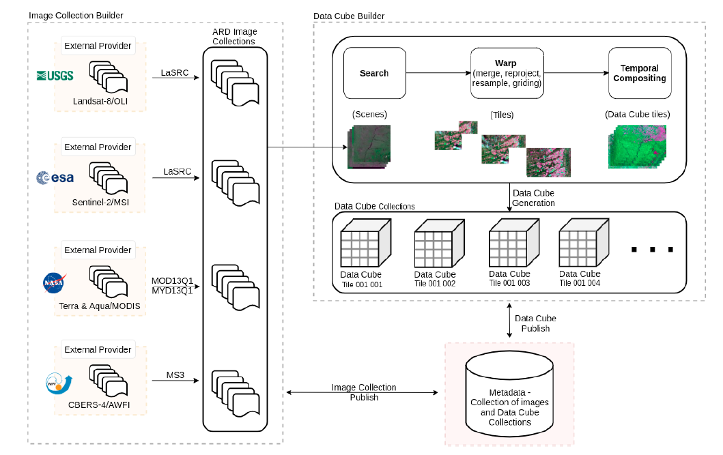
BDC
Brazil Data Cube

Slide 21
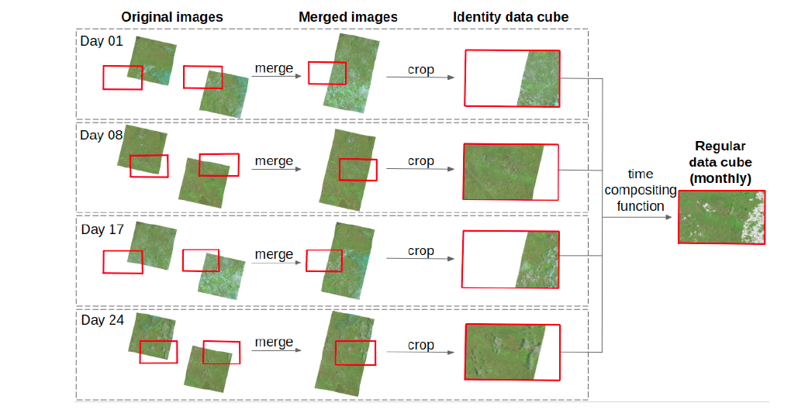

Slide 22
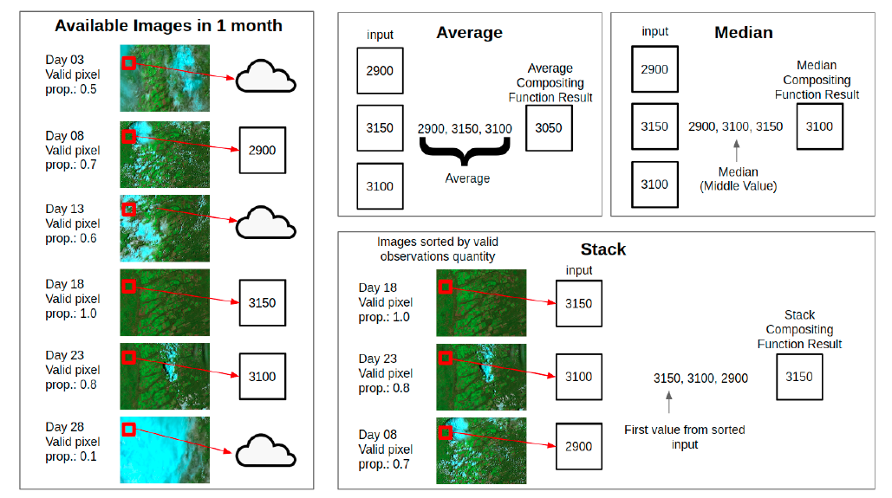

Slide 23
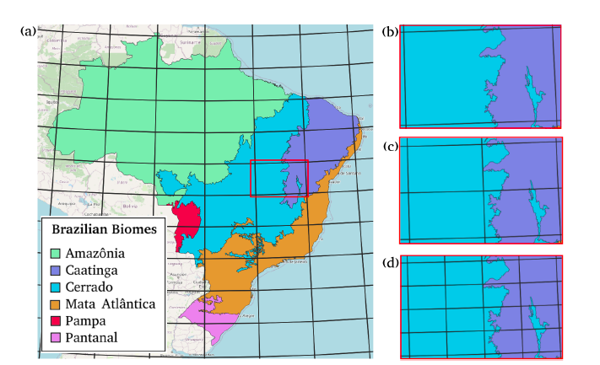
CBERS AWFI
Large tiles
(6 x 4 degrees)
LANDSAT
Medium tiles
(6 x 4 degrees)
Sentinel-2
Small tiles
(1.5 x 1 degrees)
BDC – Albers Equal Area and SIRGAS 2000

Slide 24
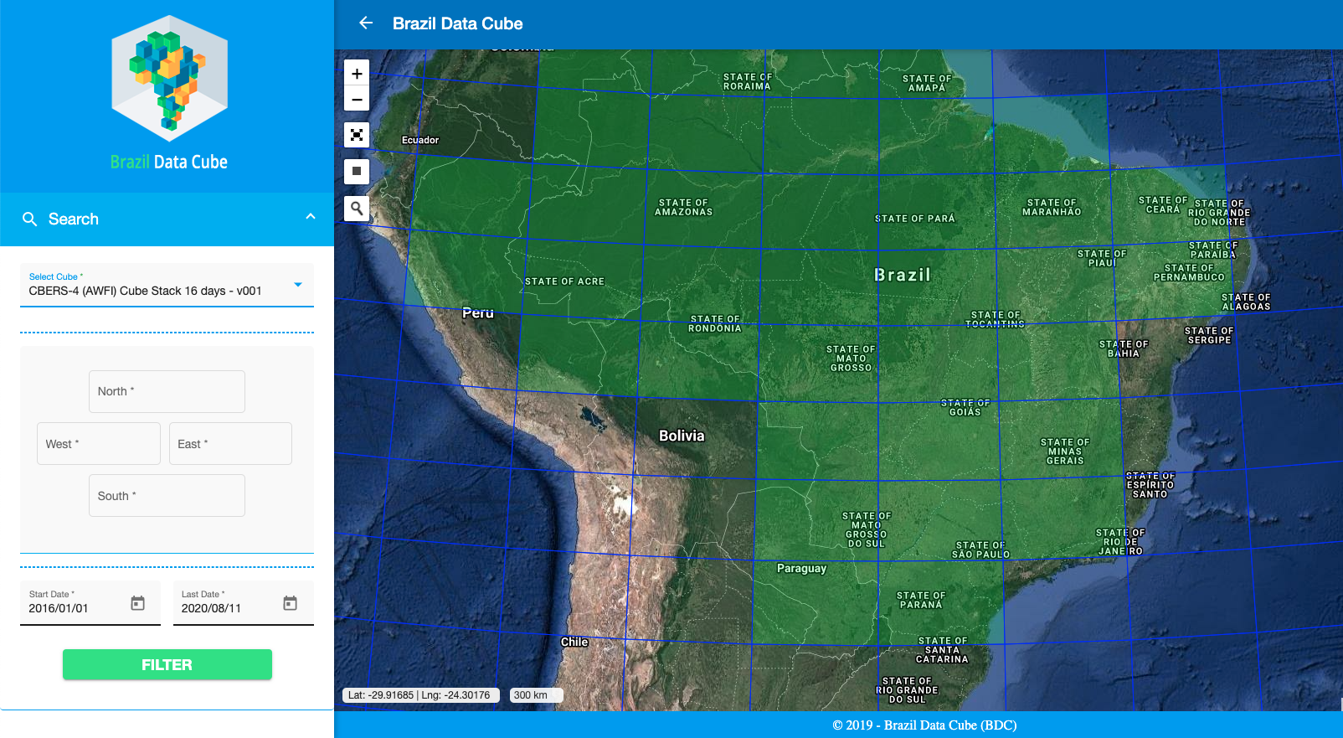

Slide 25
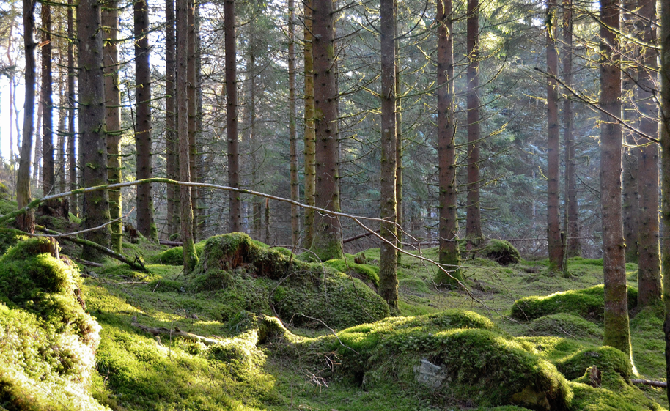
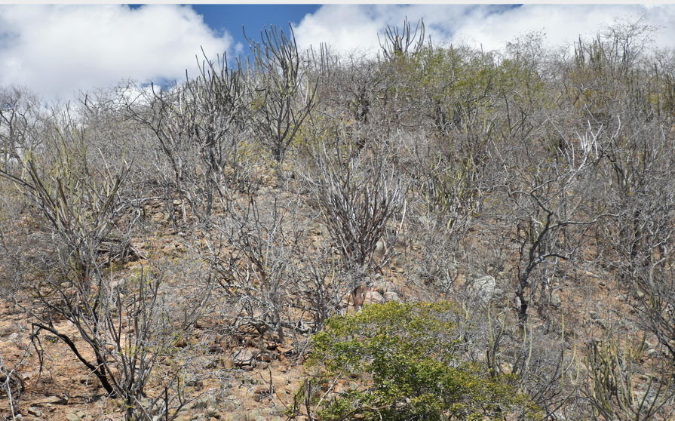
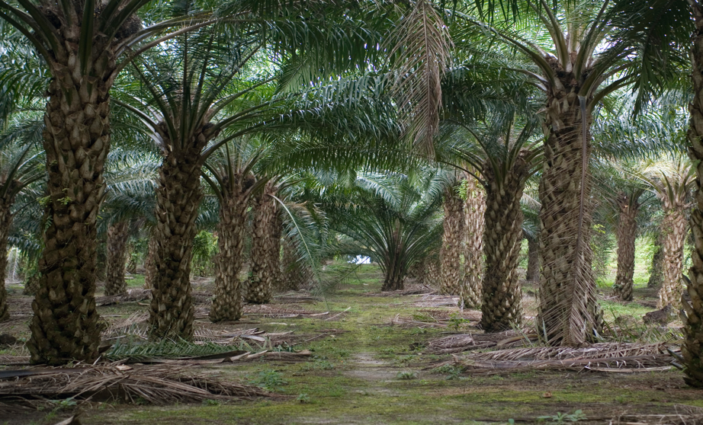
Tropical forest
Temperate forest
Dry forest
Planted forest

Slide 26
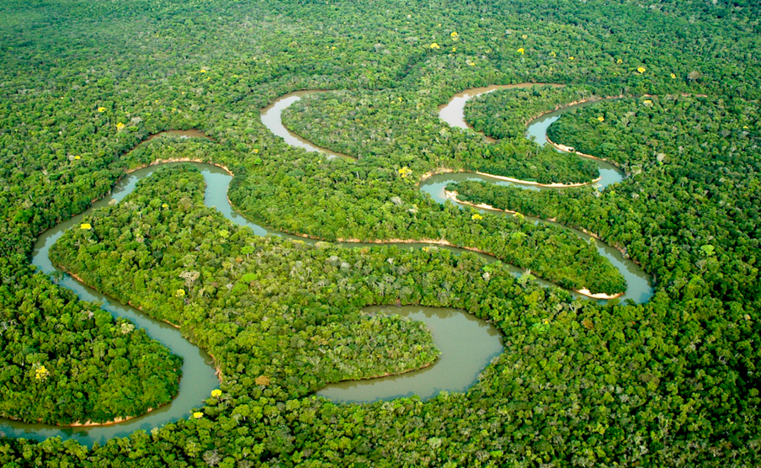
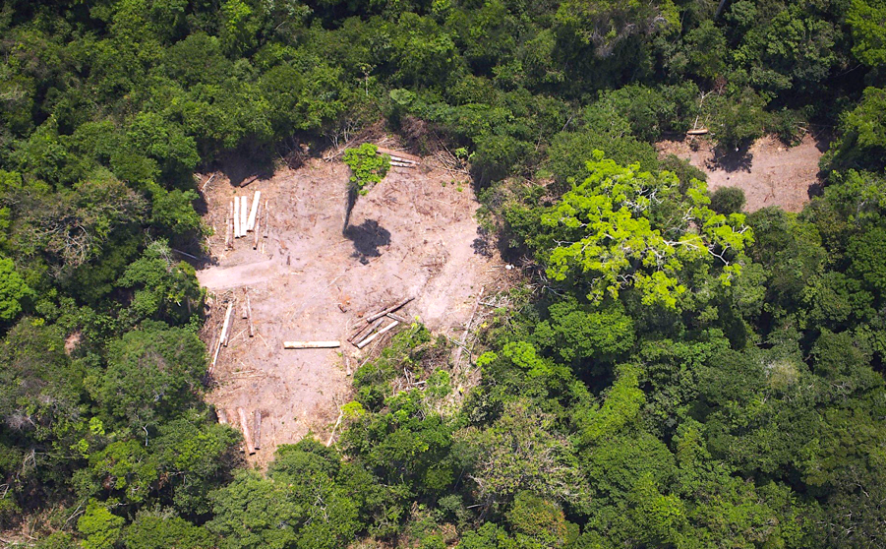
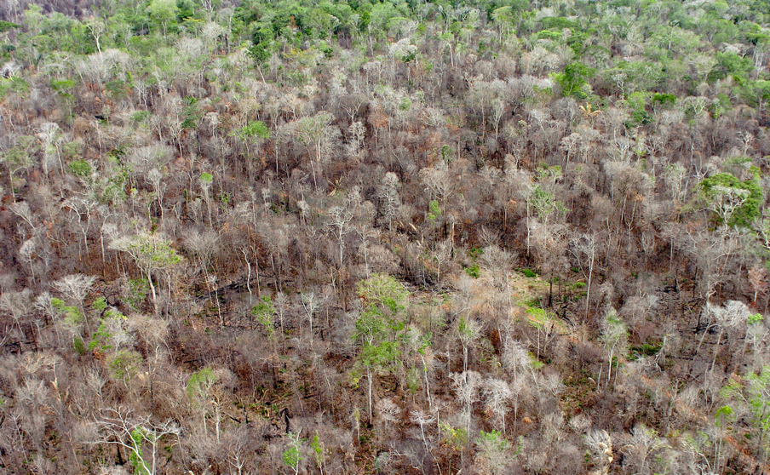
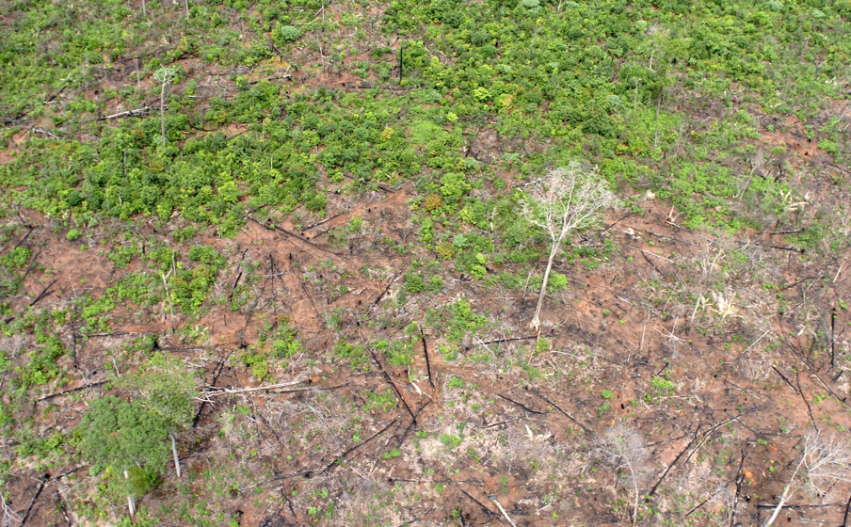
Deforestation as an event
Pristine forest
Degradation by logging
Degradation by fire
Clear-cut

Slide 27
Distinguishing forests by temporal evolution
source: Chazdon et al (2016)

Slide 28
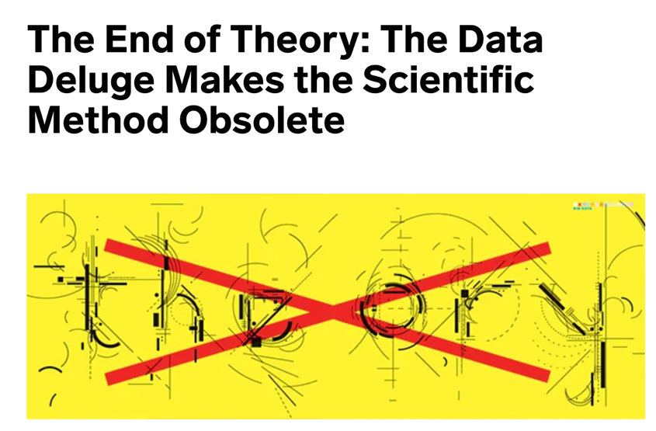
George Box (Univ Wisconsin): “All models are wrong, but some are useful”
Chris Anderson (Wired): “What can Science learn from Google?”
Peter Norvig (Google): “All models are wrong, and increasingly you can succeed without them”.

Slide 29


“Black holes are simpler than forests and Science has its limits”
Sir Martin Rees
(Astronomer Royal)
“More is different” (Anderson, Science 1972)

Slide 30
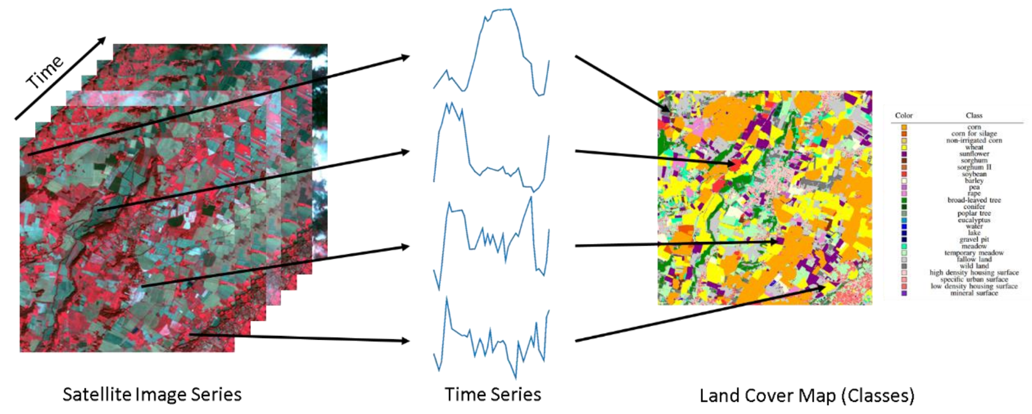
Using time series for land use and land cover change
image: F Petitjean, Monash Univ
Extract samples from a data cube
Train a machine learning model
Classify all time series for a chosen period

Slide 31
Big EO data analysis in practice
Obtain and harmonise ARD
Collect training data (in-situ)
Put ARD in a cloud collection
Quality control on training data
Build a data cube
Select ML method
Train data set
Classify data
Smoothen data
Post-processing

Slide 32
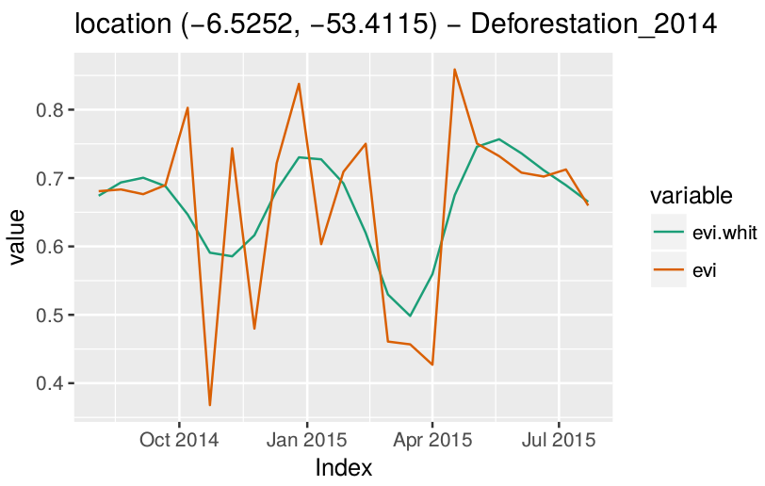
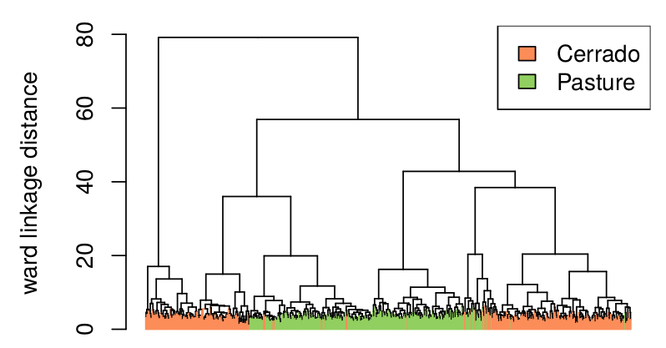

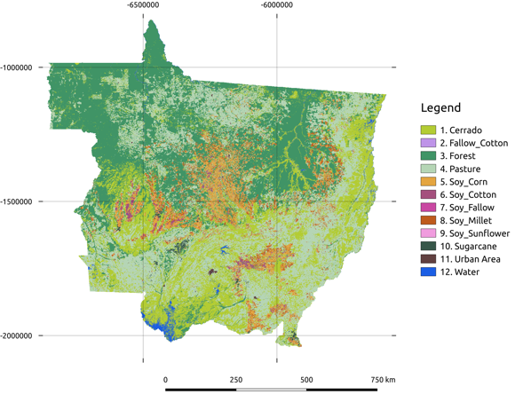
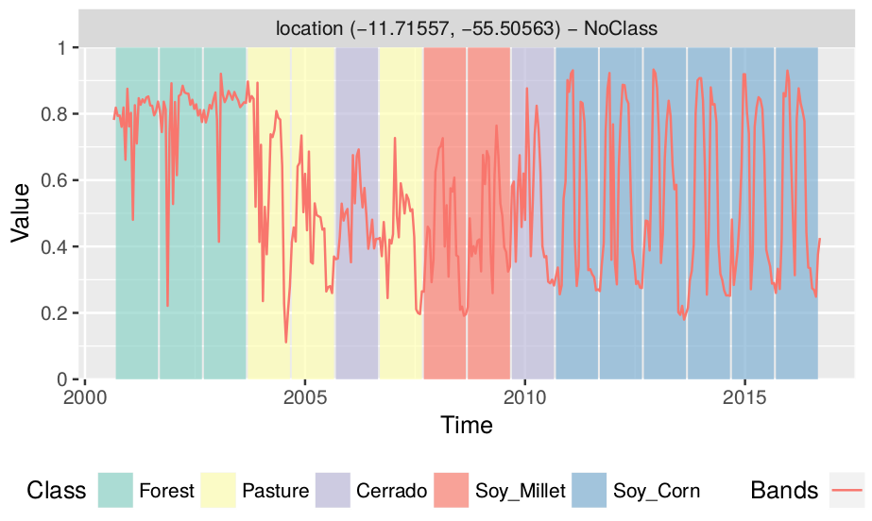
SITS – image time series analysis in R
section title / slide title
https://github.com/e-sensing/sits

Slide 33
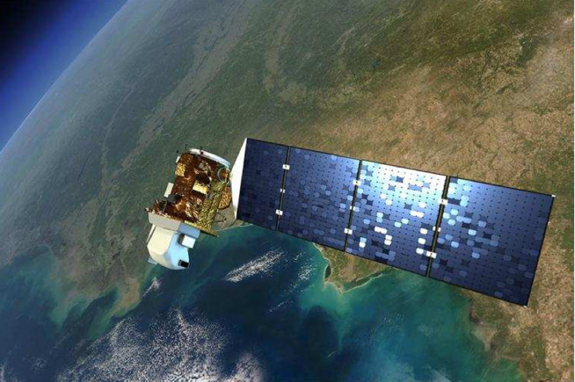
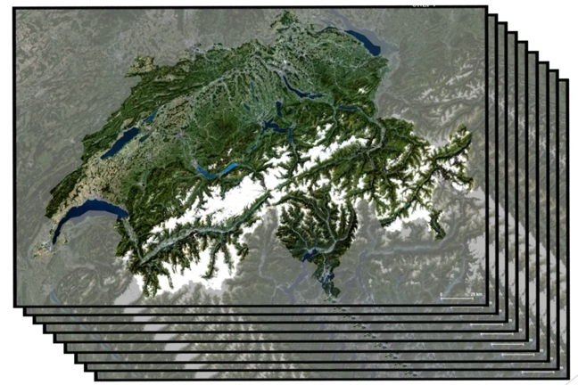
Big EO data for sustainable development
Big satellite data
(2PB per day)
Data cubes
(consistent observations)
Machine learning
(classification)
In what ways is big spatial data special?
images: NASA, Swiss Data Cube, ECMWF

Slide 34
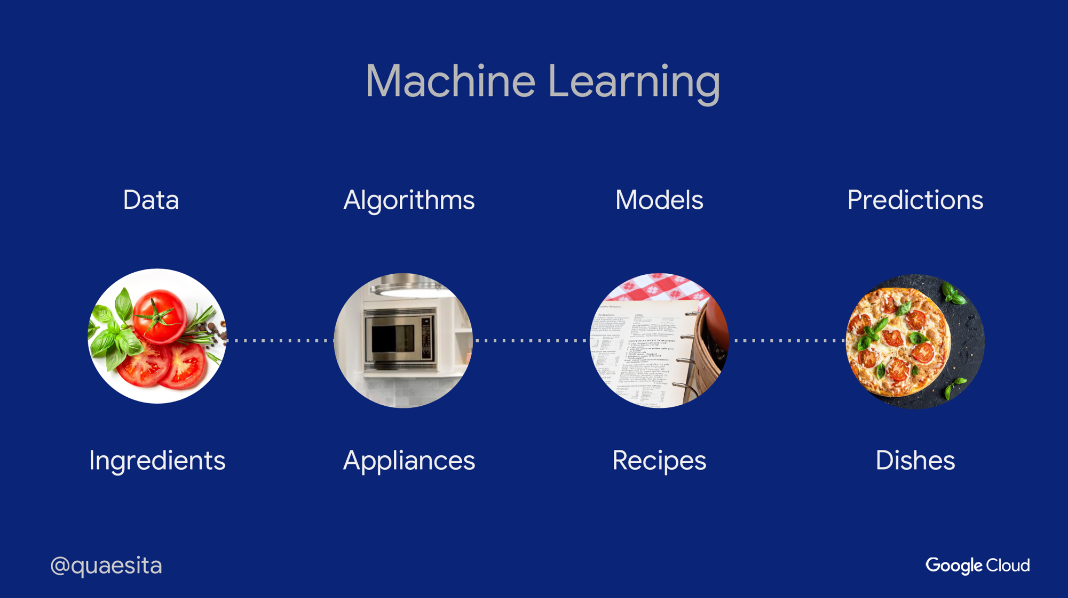
image: Cassie Kozyrkov (Google)

Slide 35


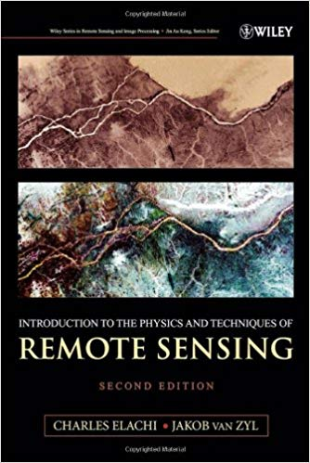
Earth observation data analysis: no secrets!
Open knowledge: books, papers, software

Slide 36
What are the limits of machine learning?
What works for face recognition, automatic translation, and Chess/Go games does also work for big spatial data?
image: manmax31.github.io

Slide 37
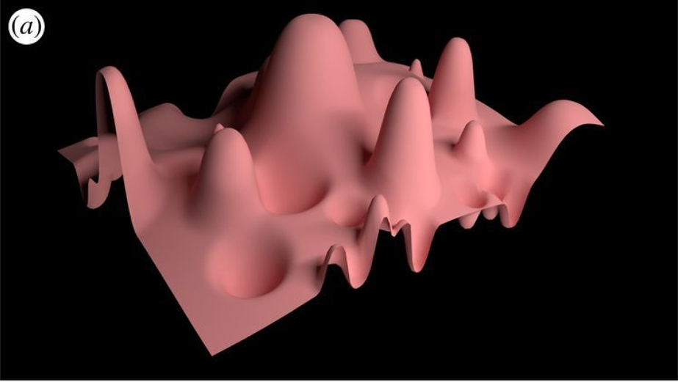
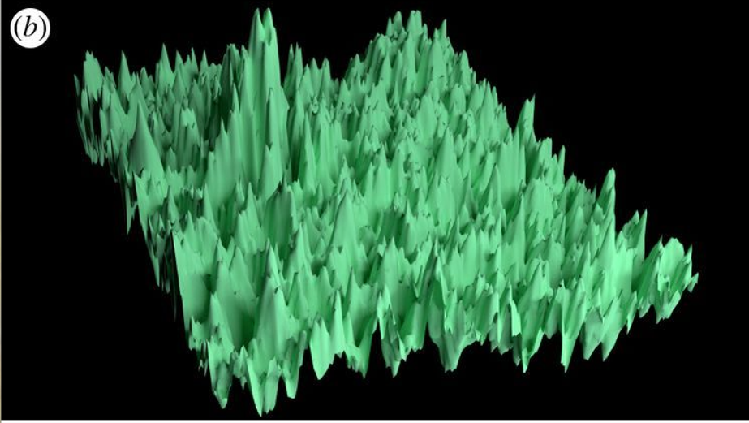
Machine learning in simulated landscapes
Small variability: easy for ML
Large variability: hard for ML
Machine learning relies on optimization and works best on problems with low variability
source: Coveney et al., “Big data need big theory too” (2017)

Slide 38
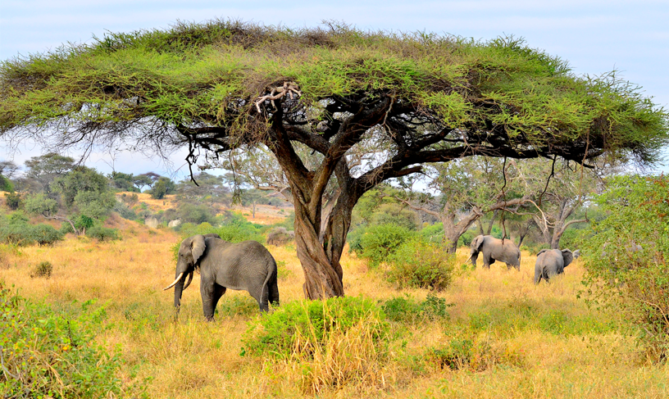


The elephant in the room
The Elephant in the savanna
Ecosystems are highly variable
Local knowledge is essential
Big satellite data
Data cubes
Machine learning
images: Alamy, NASA, Swiss Data Cube, ECMWF

Slide 39
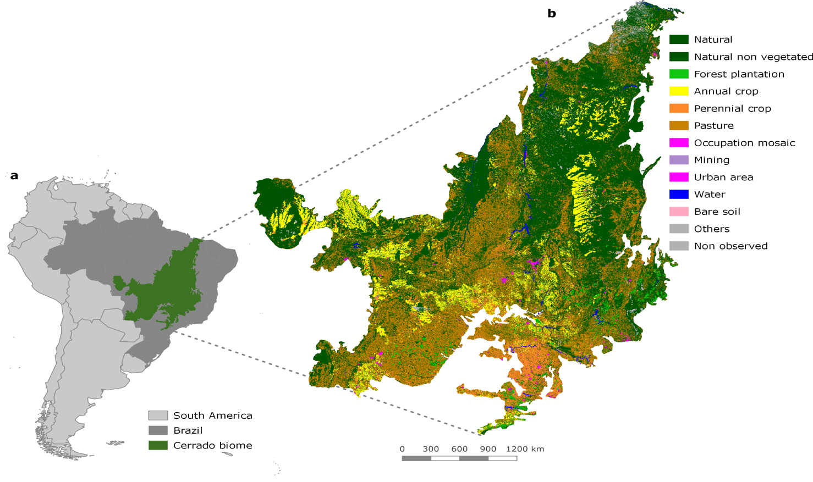
Cerrado: Brazilian Savanna
covers 2 million km², latitude ranges from 5⁰S to 25⁰S
image: TerraClass, INPE/EMBRAPA

Slide 40
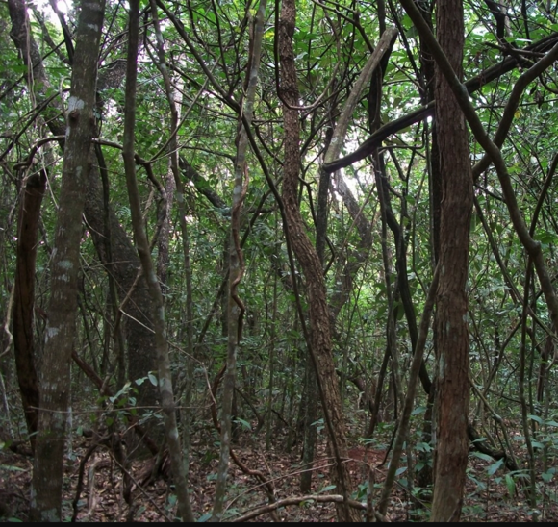
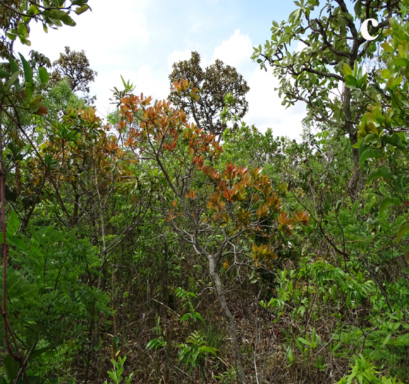
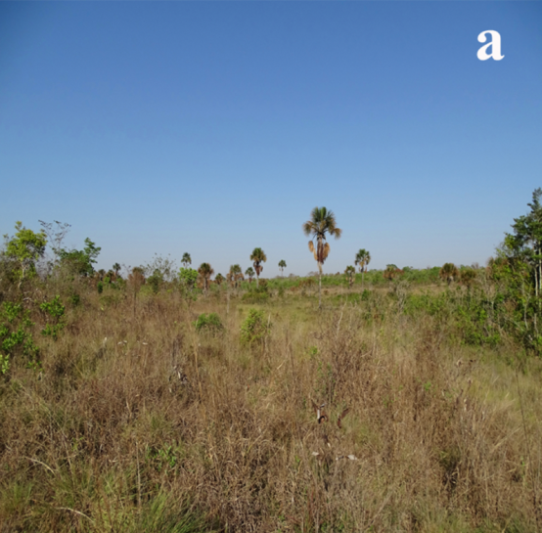

Cerrado: Brazilian savanna
Cerradão (woodland)
Cerrado strictu sensu
Open cerrado
images: Del-Claro and Silingardi (Annals Brazilian Academy Sci, 2019 )

Slide 41

Finding: Good quality samples are key

Slide 42

Finding: k-fold validation is not enough
Model | 5-fold validation accuracy
SVM | 97.6%
Random Forest | 98.5%
Perceptron | 99.2%
FCNN | 98.9%
tempCNN | 99.1 %
ResNet | 99.0%
Brazilian Amazonia – MODIS data
33,000 samples
Models fit samples well, but do they represent reality?

Slide 43







Finding: memory management of data cubes constrains data analysis
Memory cache

Slide 44


define_cube
samples
cube
get_data
train
classify
model
A simple API for data cubes

Slide 45

Building a global community of public and private actors
Open Earth Alliance
Open source: vendor independence, level-playing field, globally accesible

